Slide 1


SRI TA1 NuSymCORE
DARPA Symbiotic Design for Cyber Physical Systems
Principal Investigator: Susmit Jha
Team: Adam Cobb, Daniel Elenius, Anirban Roy, Kaushik Koneripalli, Chris McComb
Neurosymbolic Computing and Intelligence (NuSCI))
Computer Science Laboratory, SRI
Prepared for: Dr. Matthew Wilding, DARPA I20
Date: December 12, 2022
This research was developed with funding from the Defense Advanced Research Projects Agency (DARPA). The views, opinions and/or findings expressed are those of the author and should not be interpreted as representing the official views or policies of the Department of Defense or the U.S. Government. This research was supported by Contract No. FA8750-20-C-002.

Slide 2
Talk Outline
Key Challenges in CPS Design and Desiderata of an AI Co-Designer
Overview of Trinity AI Co-Designer
Invertible Neural Networks
Hamiltonian MCMC over Uncertainty-quantified Generative VAE Model
Neuro-symbolic Generator Using Language Models for Symbiosis
Results on Program (TA3) Corpus and Hackathons: Athens and Nautilus
Top-down Design for Athens
Bottom-up Design for Nautilus
Conclusion
Program Metrics
TA2 Interaction
Publications
Distribution Statement A. Approved for Public Release, Distribution Unlimited

Slide 3
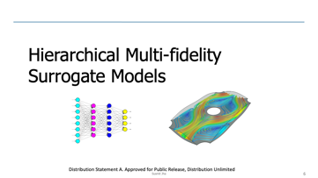
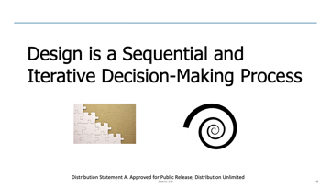
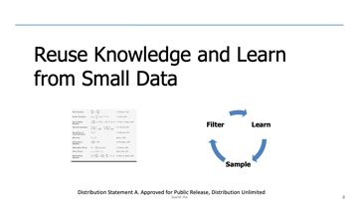
Key Challenges in CPS Design and Desiderata of an AI Co-Designer
Distribution Statement A. Approved for Public Release, Distribution Unlimited

Slide 4


Design is a Sequential and Iterative Decision-Making Process
Distribution Statement A. Approved for Public Release, Distribution Unlimited

Slide 5
Design is a Sequential and Iterative Decision-Making Process
Design process is a sequential and iterative decision-making process.
Incomplete specification that is refined during the design process. Need to avoid over-concretization.
In place of single optimum design, discover a diverse set of designs.
Compositional representation and exploration of design
Hierarchy of parts and subsystems. E.g., faring and pressure-vessel design in UUV design
Composition of aspects / domains / physics. E.g., design of propulsion subsystem, pitch/roll subsystem
Distribution Statement A. Approved for Public Release, Distribution Unlimited

Slide 6
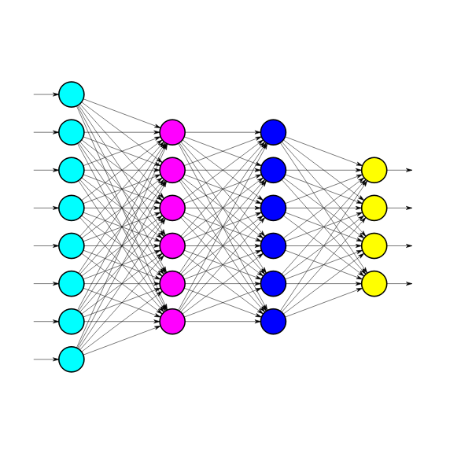
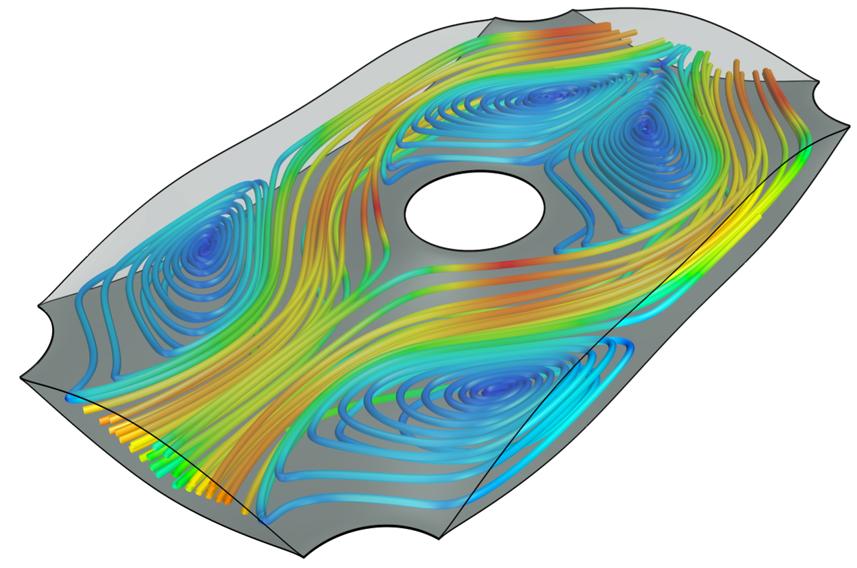
Hierarchical Multi-fidelity Surrogate Models
Distribution Statement A. Approved for Public Release, Distribution Unlimited

Slide 7
AI-driven Design needs Hierarchical Multi-fidelity Surrogate Models
AI codesigner can query models (physics or ML-based) or humans as oracles to guide their decision steps.
Physics-based scientific models (e.g., computational fluid dynamics models) are slow to evaluate.
Need to accelerate these models with learned hierarchical surrogates.
The accuracy/fidelity/cost of learned surrogates are different at different stages of the design.
Some design-decisions need component/subsystem-specific surrogate model.
Distribution Statement A. Approved for Public Release, Distribution Unlimited

Slide 8
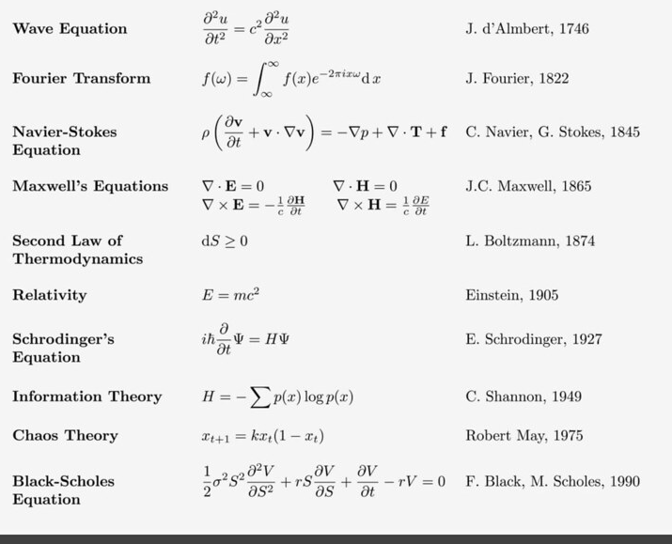
Reuse Knowledge and Learn from Small Data
Learn
Sample
Filter
Distribution Statement A. Approved for Public Release, Distribution Unlimited

Slide 9
AI-codesigner needs to reuse knowledge and learn from small data
AI codesigner needs to reuse existing domain knowledge : basic physics, domain-specific design rules, human intuition such as seed designs.
Evaluation of design is costly, and the number of design epochs are few. Hence, AI co-designer needs to learn from small data.
Need methods to filter and lift failures to rules.
Need for smarter and adaptive data-generation
The AI designer needs to not just optimize for a single design problem against a fixed specification but instead be an adaptive agent learning across design iterations and problems.
Learn
Sample
Filter
Distribution Statement A. Approved for Public Release, Distribution Unlimited

Slide 10
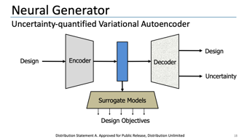
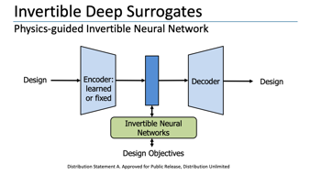
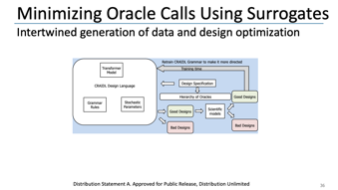
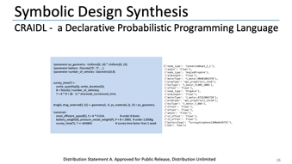
Overview of Trinity AI Co-Designer
Distribution Statement A. Approved for Public Release, Distribution Unlimited

Slide 11
Invertible Deep Surrogates
Physics-guided Invertible Neural Network
Design
Encoder: learned
or fixed
Decoder
Design
Invertible Neural Networks
Design Objectives
Distribution Statement A. Approved for Public Release, Distribution Unlimited

Slide 12
Design as an Inverse Problem
Forward prediction
X
Scientific Models
y
Design
(latent space / parameters)
Output
(design objectives / measurements)
Backward inversion
Inverse problem: Generate design corresponding to a given design objective
In many applications, the forward scientific model can be slow/expensive and can only be sparsely sampled, thus an inverse model can help generate novel designs with desired specifications
While the forward model is well-defined and can be approximated in a supervised learning setup, the inverse problem is ill-defined due to the ‘many-to-one’ mapping from inputs to outputs.
Distribution Statement A. Approved for Public Release, Distribution Unlimited

Slide 13
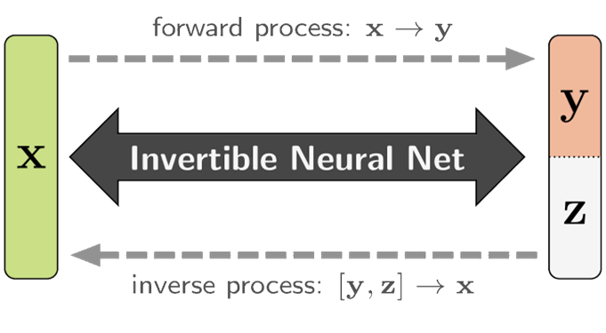
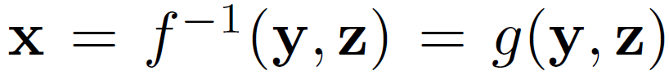
Invertible Neural Networks
Invertible neural network framework with inputs (X), outputs (y) and latent variable (z)
As there is an information loss during the forward process f(x ->y), latent variable (z) is introduced to capture the information about X that is not present in y
This allows to learn the inverse process as:
where f() and g() are modeled by invertible neural networks
Useful for motor-propeller-battery choice (propulsion subsystem for UAV) + Fairing Design for UUV
Distribution Statement A. Approved for Public Release, Distribution Unlimited

Slide 14
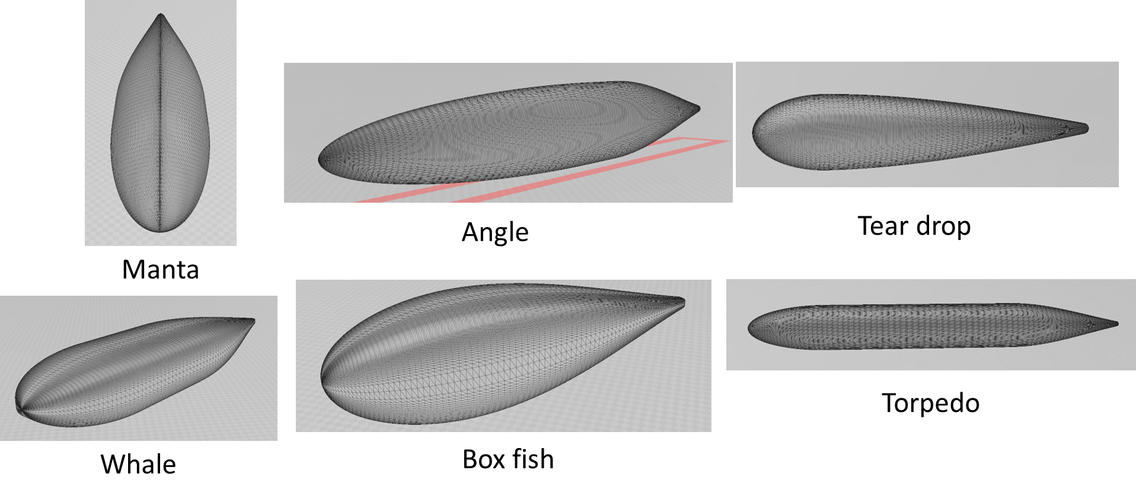
Example Application: Fairing design
The goal of fairing design is to generate shapes that
experience less drag forces,
pack the required components, and
efficiently navigate (good controllability) through the mission path
We consider a parametric representation of fairing shapes
Parameters control various aspects of the fairing such as nose shape and length, tail shape and length, size and length of the body, curvatures of the body etc.
We consider the fairing design tool provided by the STR TA3 team (parameterized Myring hulls)
Distribution Statement A. Approved for Public Release, Distribution Unlimited

Slide 15
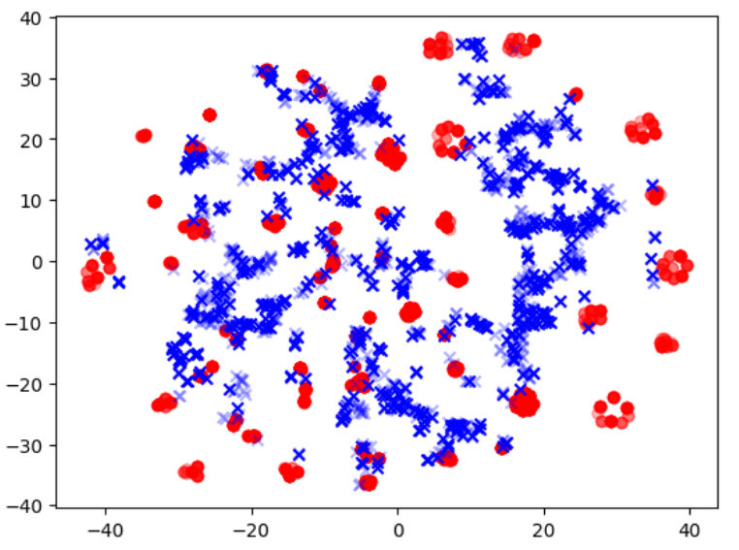
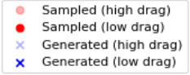
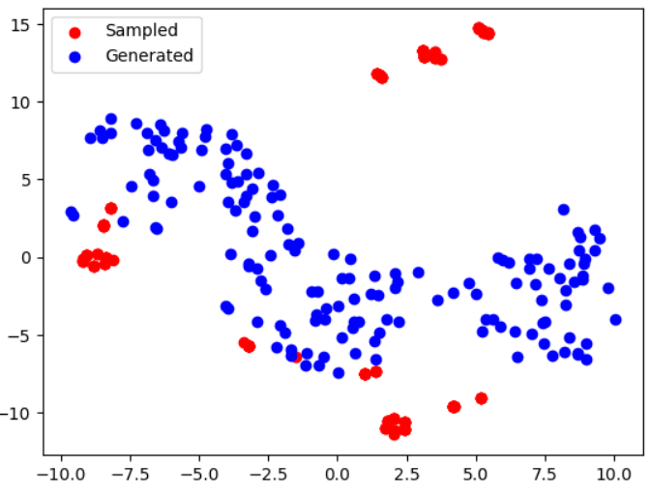
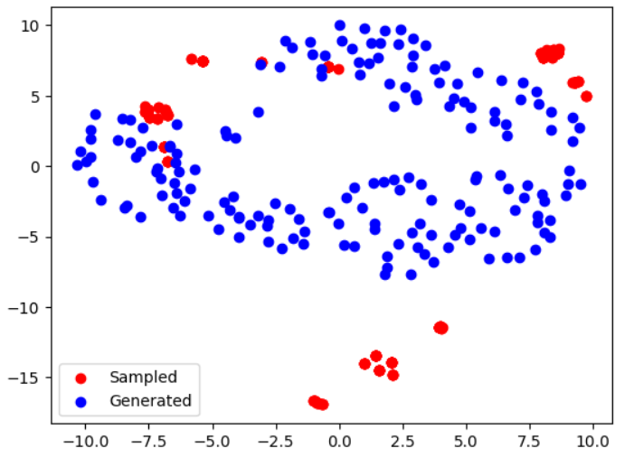
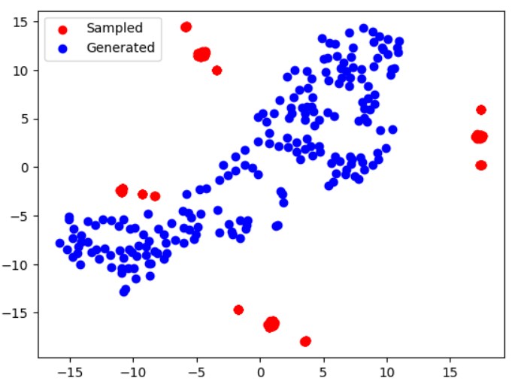
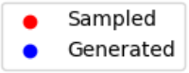
INNs can reliably generate diverse fairing designs for given type of shapes
Average error: 7.48%
Speed up: order of 1000X
High Diversity
Comparison of diversity between sampled and generated designs
T-SNE plot to compare sampled vs generated fairing shapes
Angle
Manta
Torpedo
Distribution Statement A. Approved for Public Release, Distribution Unlimited

Slide 16
INNs can reliably generate fairing designs for given drag properties
T-SNE plot to compare sampled vs generated fairing shapes
Low Drag Fairings are Faded Points
Distribution Statement A. Approved for Public Release, Distribution Unlimited

Slide 17
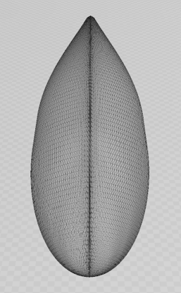
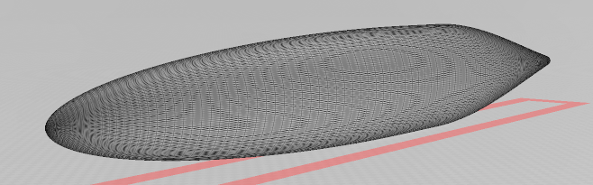
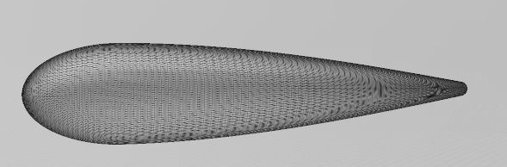
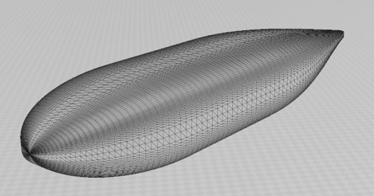
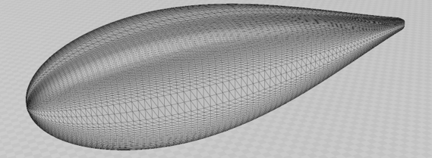
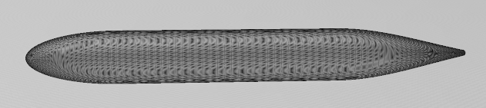
Discovery of diverse shapes (UUV fairings) of comparable volume with low drag
 | V = 1 | V = 2 | V = 5
Angle | 0.094 / 57.76 | 0.087 / 214.66 | 0.078 / 1197.91
Box | 0.048 / 58.38 | 0.044 / 217.14 | 0.039 / 1214.79
Manta | 0.062 / 56.55 | 0.058 / 210.75 | 0.052 /1182.66
Teardrop | 0.052 / 53.85 | 0.049 / 200.70 | 0.044 / 1126.55
Torpedo | 0.090 / 52.82 | 0.085 / 197.85 | 0.076/ 1106.09
Whale | 0.063 / 58.83 | 0.0.58 / 217.50 | 0.052 / 1220.82
Manta
Angle
Tear drop
Torpedo
Box fish
Whale
Distribution Statement A. Approved for Public Release, Distribution Unlimited

Slide 18

Neural Generator
Uncertainty-quantified Variational Autoencoder
Design
Design
Encoder
Decoder
Uncertainty
Surrogate Models
Design Objectives
Distribution Statement A. Approved for Public Release, Distribution Unlimited

Slide 19
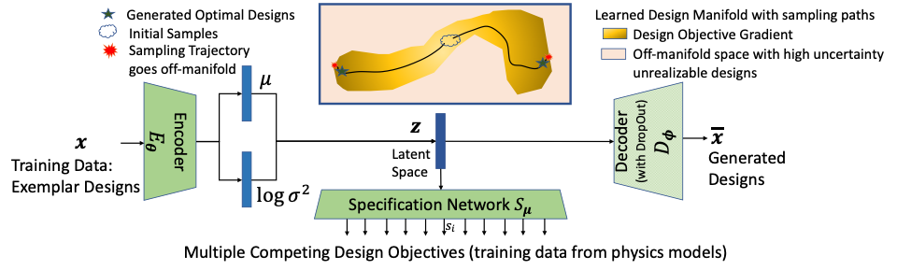
Hamiltonian MCMC over Design Manifold
Our approach uses exemplar designs to learn a variational encoder (VAE) where the decoder is trained with dropout. The specification network predicts the design objectives from the latent space.
The VAE and the specification network are jointly trained on the exemplar designs and their evaluation on physics models. In the design exploration stage, we condition on the new target design objectives and use temperature annealed HMC to sample the latent space, moving towards optimal designs exploiting the gradient information.
High variance/uncertainty implies off-manifold designs that may not be unrealizable.
Controlling HMC walk yields diverse designs.
Distribution Statement A. Approved for Public Release, Distribution Unlimited

Slide 20
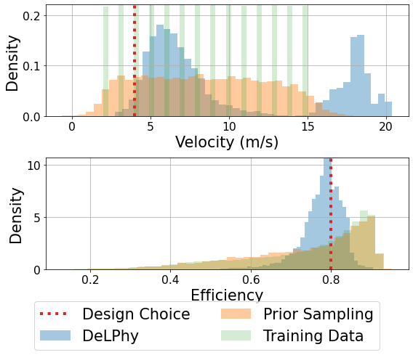
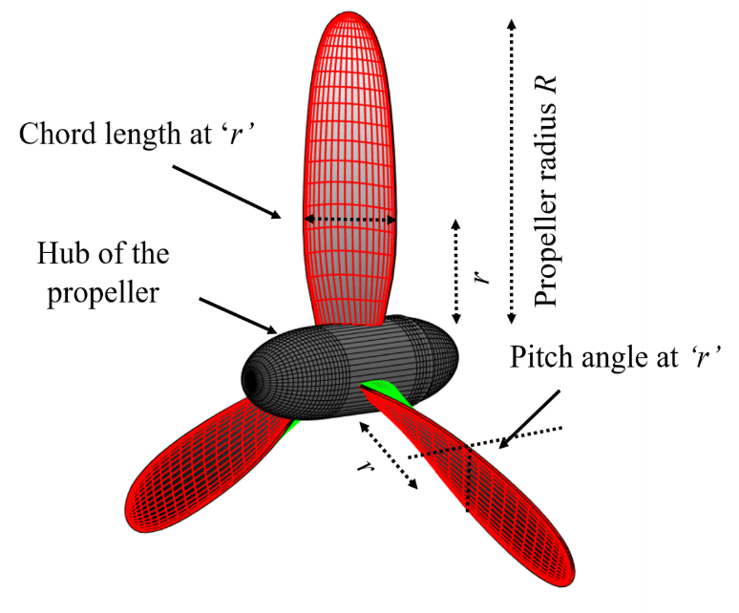
OpenProp Propeller Design
Our Approach
High efficiency at low velocity
Histograms of two competing design objectives. Simply sampling from the Gaussian prior in the latent space is not sufficient.
Distribution Statement A. Approved for Public Release, Distribution Unlimited

Slide 21
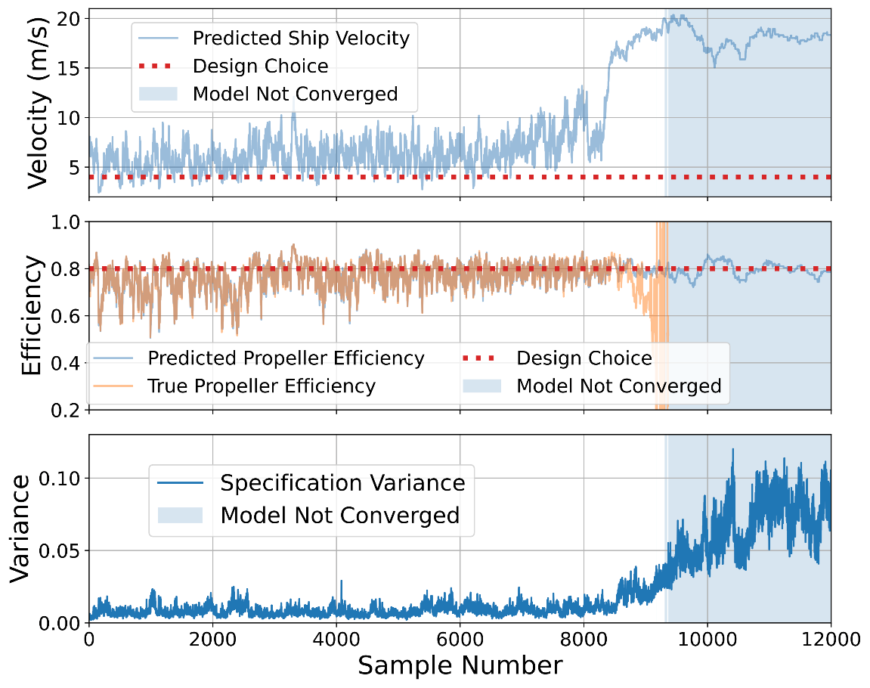
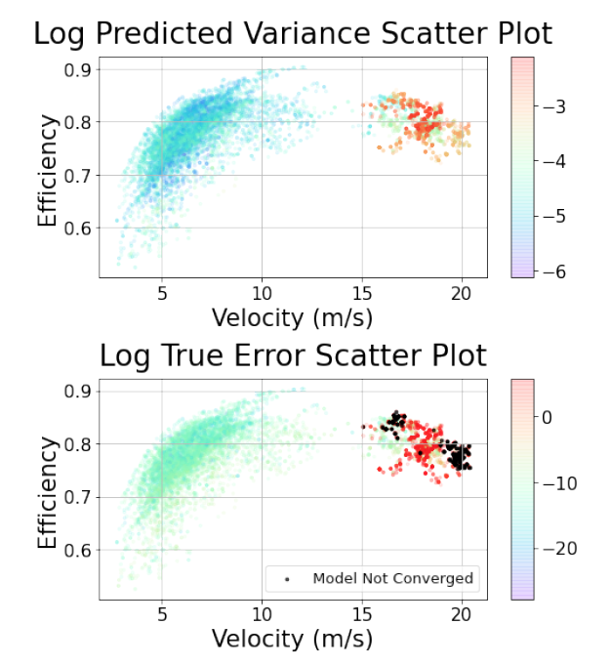
OpenProp Propeller Design
Sample trajectories of the velocity and the propeller efficiency, as well as the corresponding variance on the objectives. Around sample ID 9000, we see high velocities with high efficiency, but the corresponding variance is high, suggesting these are unreliable designs.
Distribution Statement A. Approved for Public Release, Distribution Unlimited

Slide 22
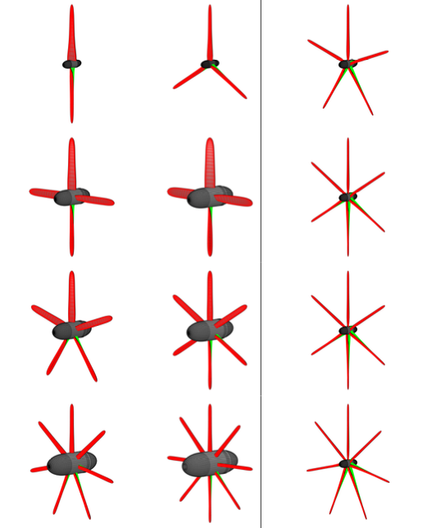
Diversity in Propeller Design
Here, our design objective was to generate efficient propellers at a low velocity (efficiency higher than 75% and velocity lower than 4.5 m/s).
Our Approach:
Creates a diverse set of propeller designs in terms number of blades, the shape of blades, pitch angles, and hub diameter.
Direct Optimization (EAs):
Creates a set of designs with a slight variation in number of blades, but the other geometric properties are similar.
Distribution Statement A. Approved for Public Release, Distribution Unlimited

Slide 23
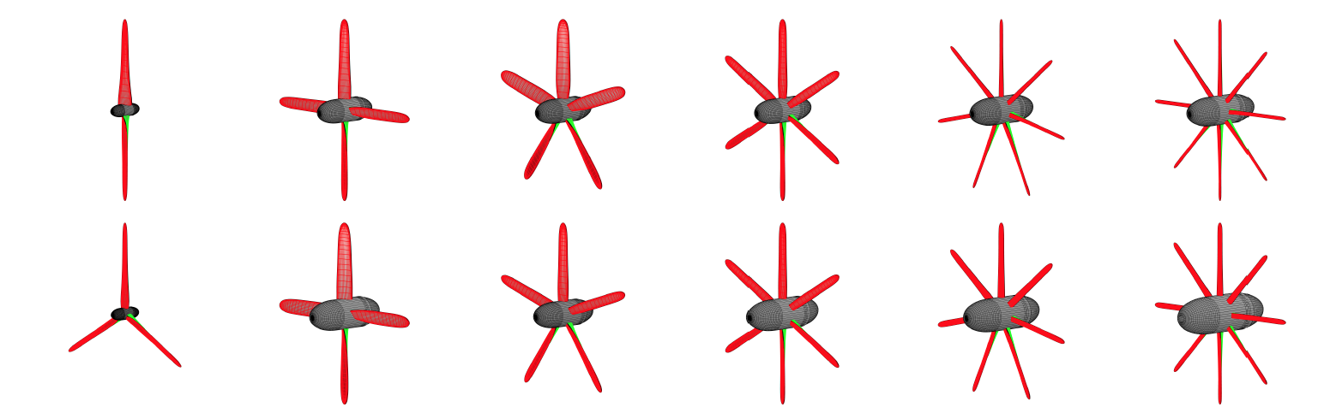
Diversity in Propeller Design
Here, our design objective was to generate efficient propellers at a low velocity (efficiency higher than 75% and velocity lower than 4.5 m/s).
Our Approach:
Creates a diverse set of propeller designs in terms number of blades, the shape of blades, pitch angles, and hub diameter.
Noise as a late specification: “ A 2-blade propeller produces two pressure pulses per revolution, whereas a 3-blade propeller will produce three smaller pulses per revolution for the same amount of total thrust.
Distribution Statement A. Approved for Public Release, Distribution Unlimited

Slide 24
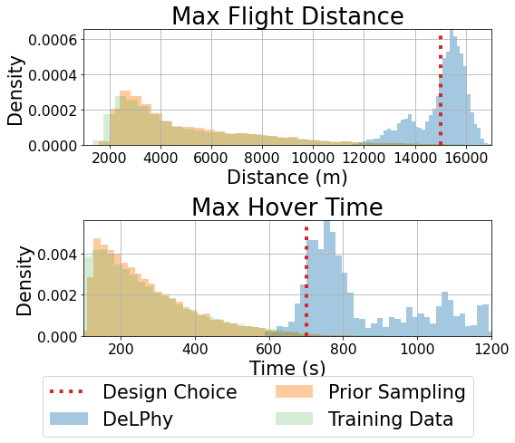
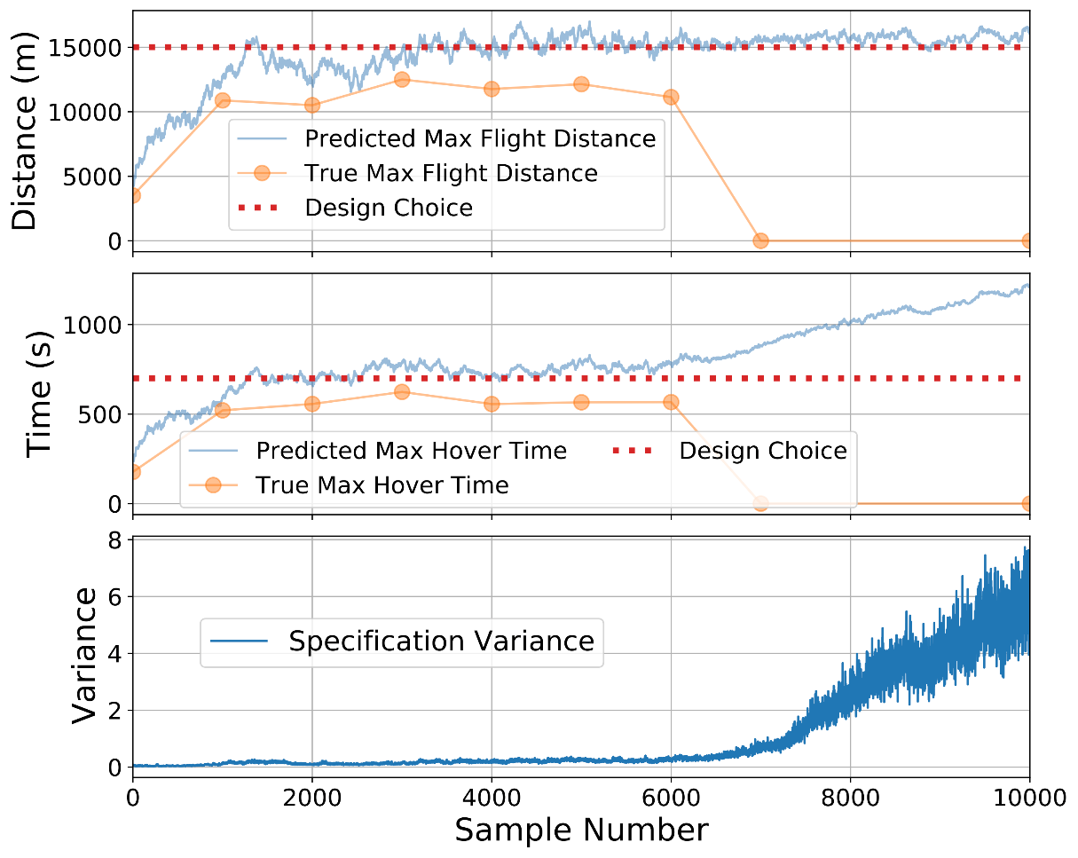
Air Vehicle Design
Our Approach
Our approach detects when the generates designs cannot be trusted using the specification variance.
Our approach samples designs that converge around the design objectives even though the training data and the prior distribution are far from it.
Distribution Statement A. Approved for Public Release, Distribution Unlimited

Slide 25
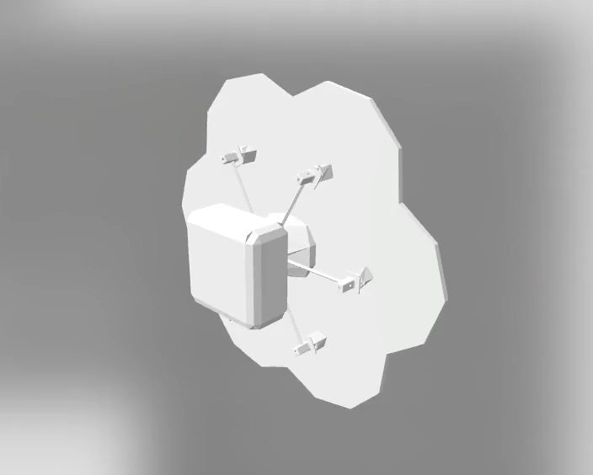
Air Vehicle Design
Distribution Statement A. Approved for Public Release, Distribution Unlimited

Slide 26
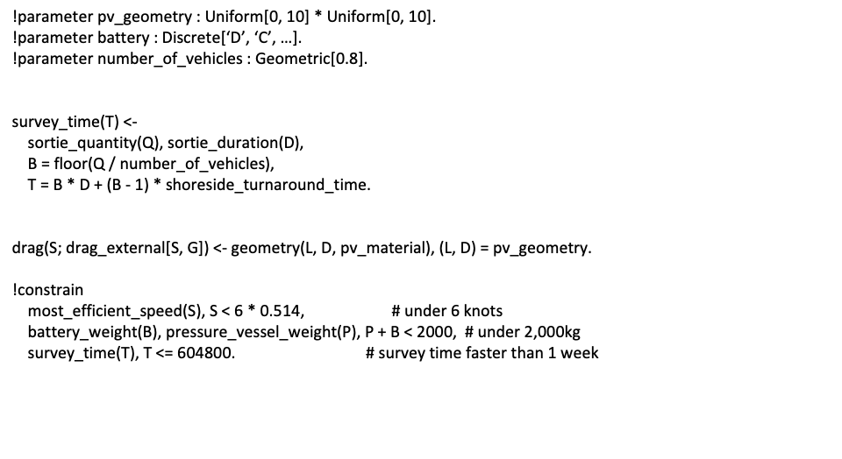
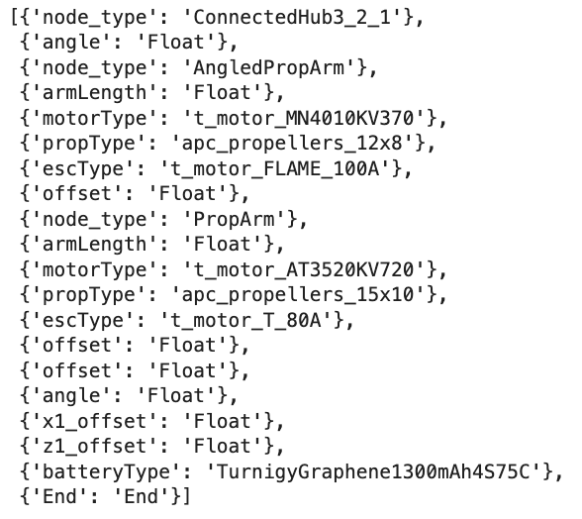
Symbolic Design Synthesis
CRAIDL - a Declarative Probabilistic Programming Language
Distribution Statement A. Approved for Public Release, Distribution Unlimited

Slide 27
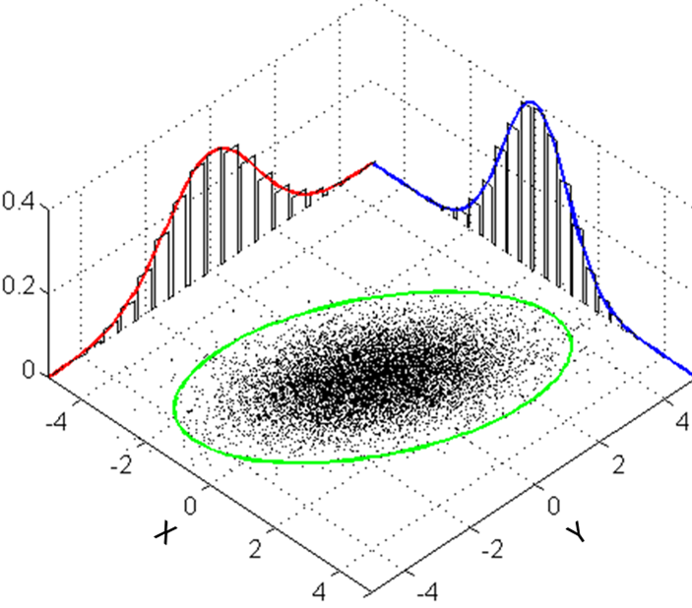
Symbolic Generator Using CRAIDL - a Declarative Probabilistic Programming Language
Probability Assigned to
Each Design Rule
Leaf Nodes have Attributes that can be coupled
Kv, Kt, Km, Ir
Diam, Pitch
Distribution Statement A. Approved for Public Release, Distribution Unlimited

Slide 28
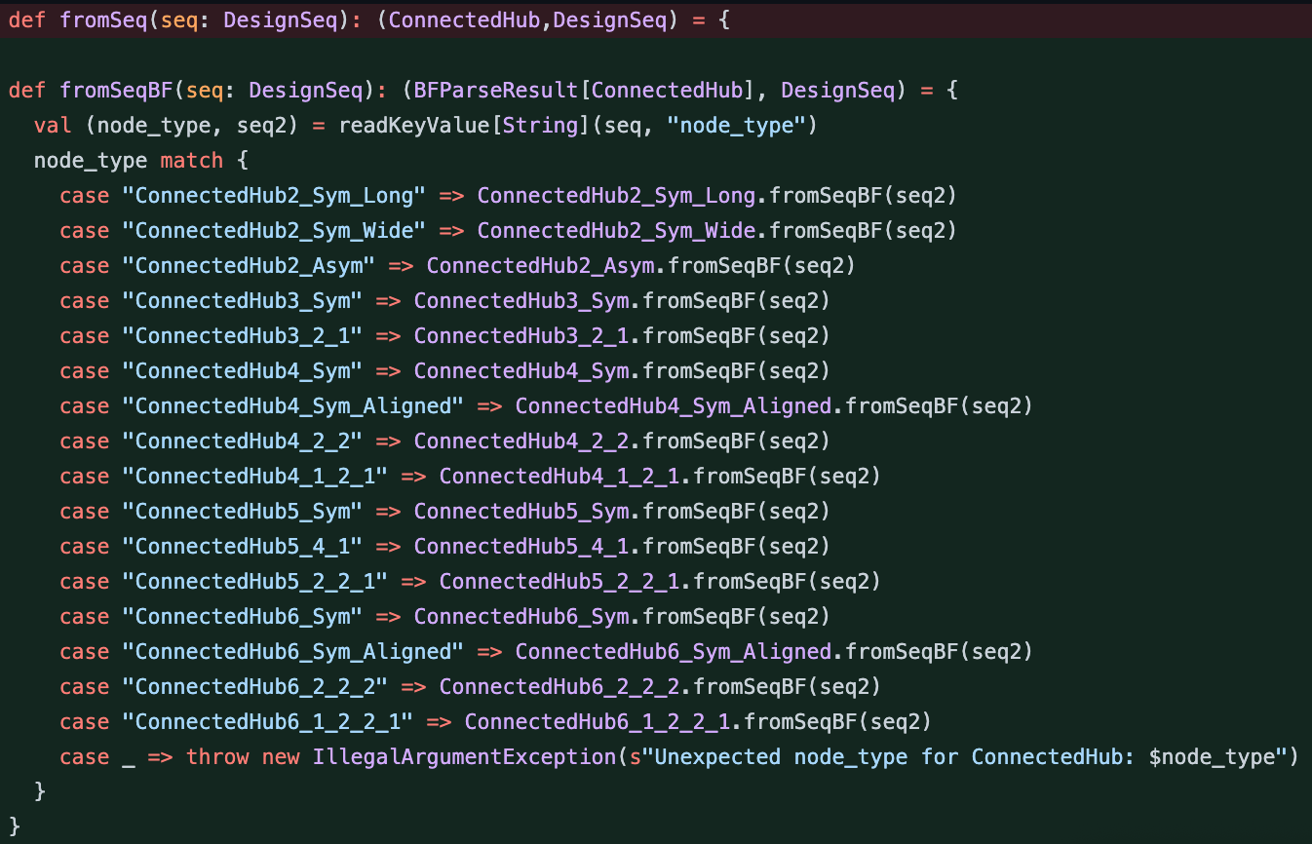
Symbolic Generator Using CRAIDL - a Declarative Probabilistic Programming Language
Map leaf nodes to corpus components
Distribution Statement A. Approved for Public Release, Distribution Unlimited

Slide 29
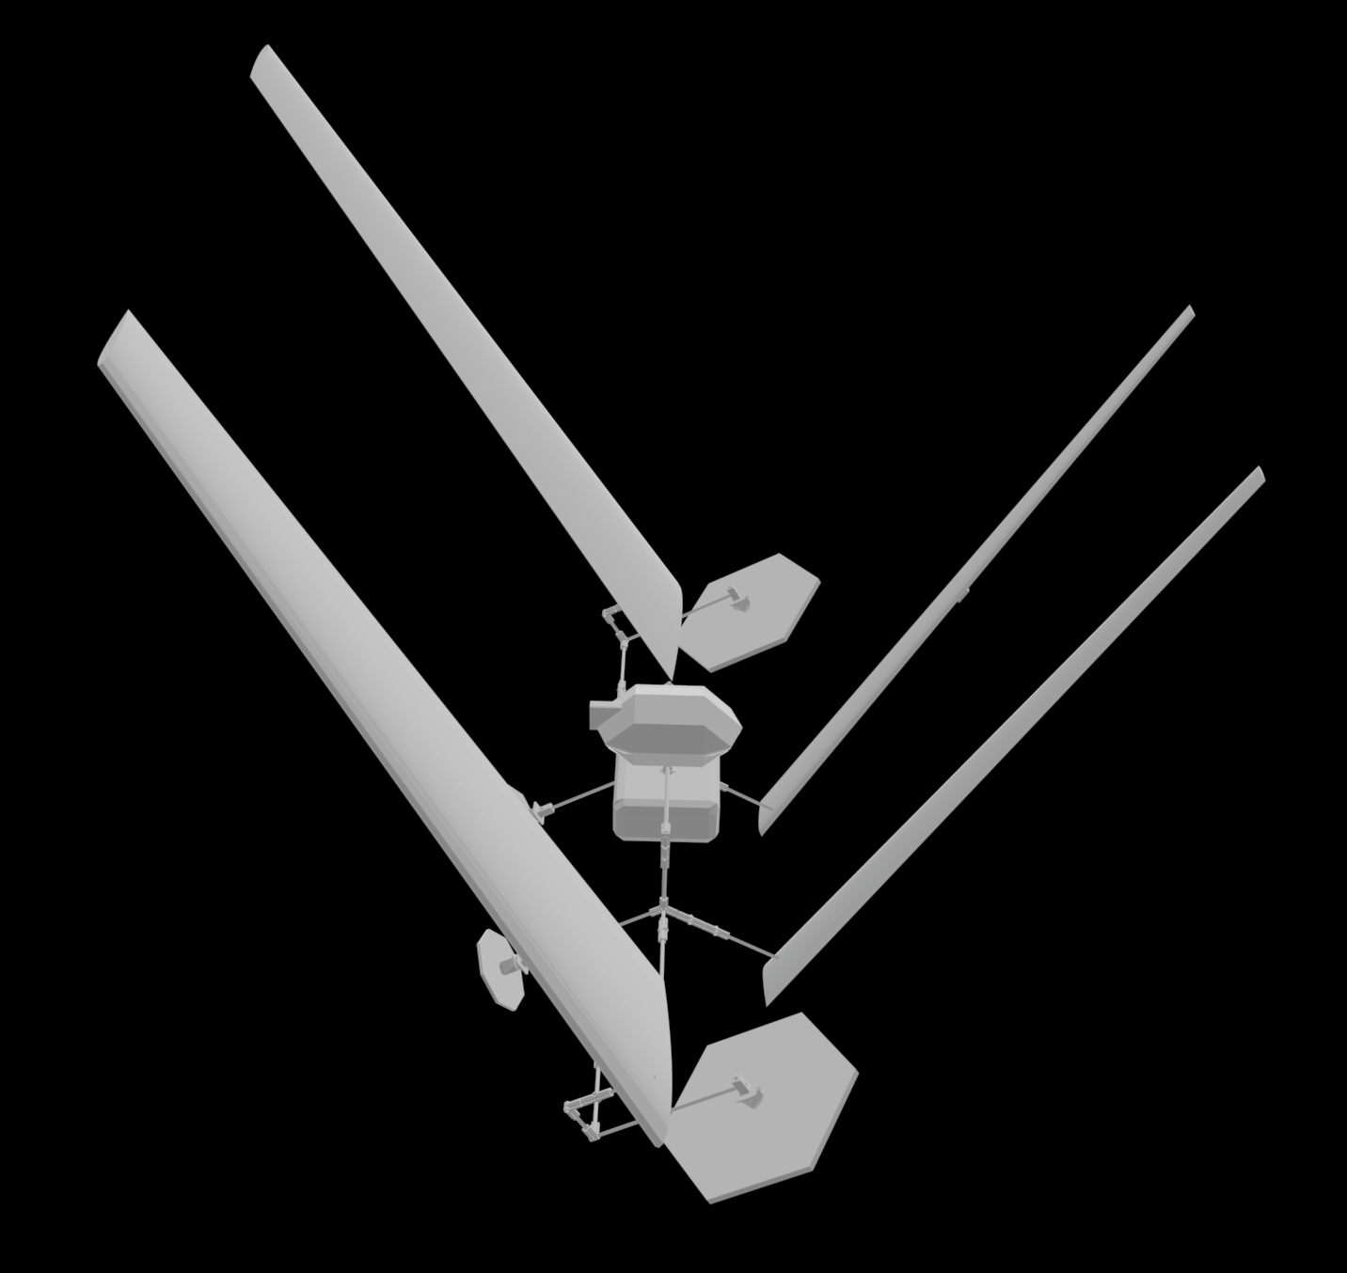
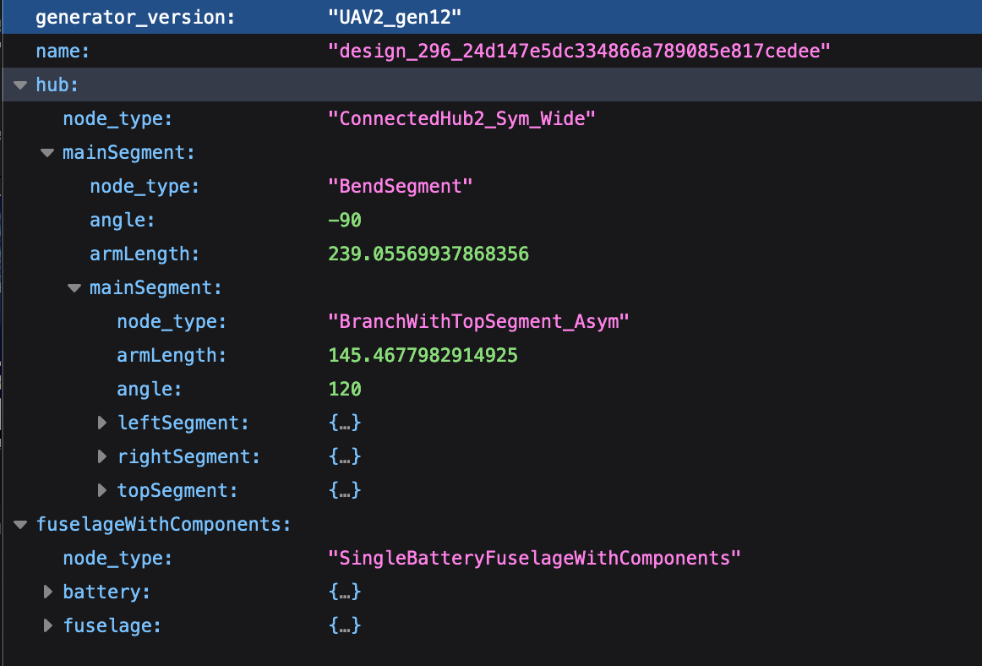
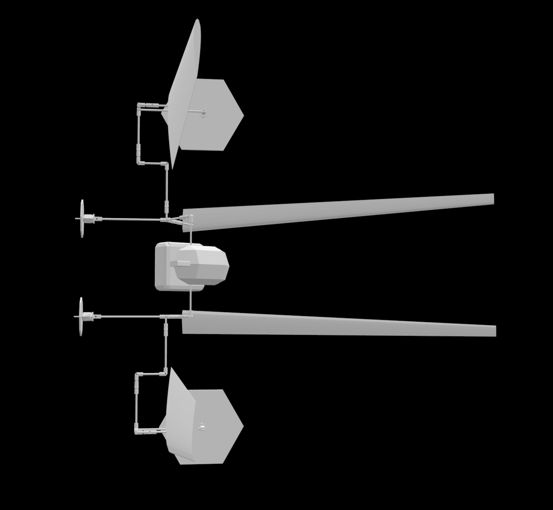
Symbolic Generator Using CRAIDL - a Declarative Probabilistic Programming Language
Distribution Statement A. Approved for Public Release, Distribution Unlimited

Slide 30
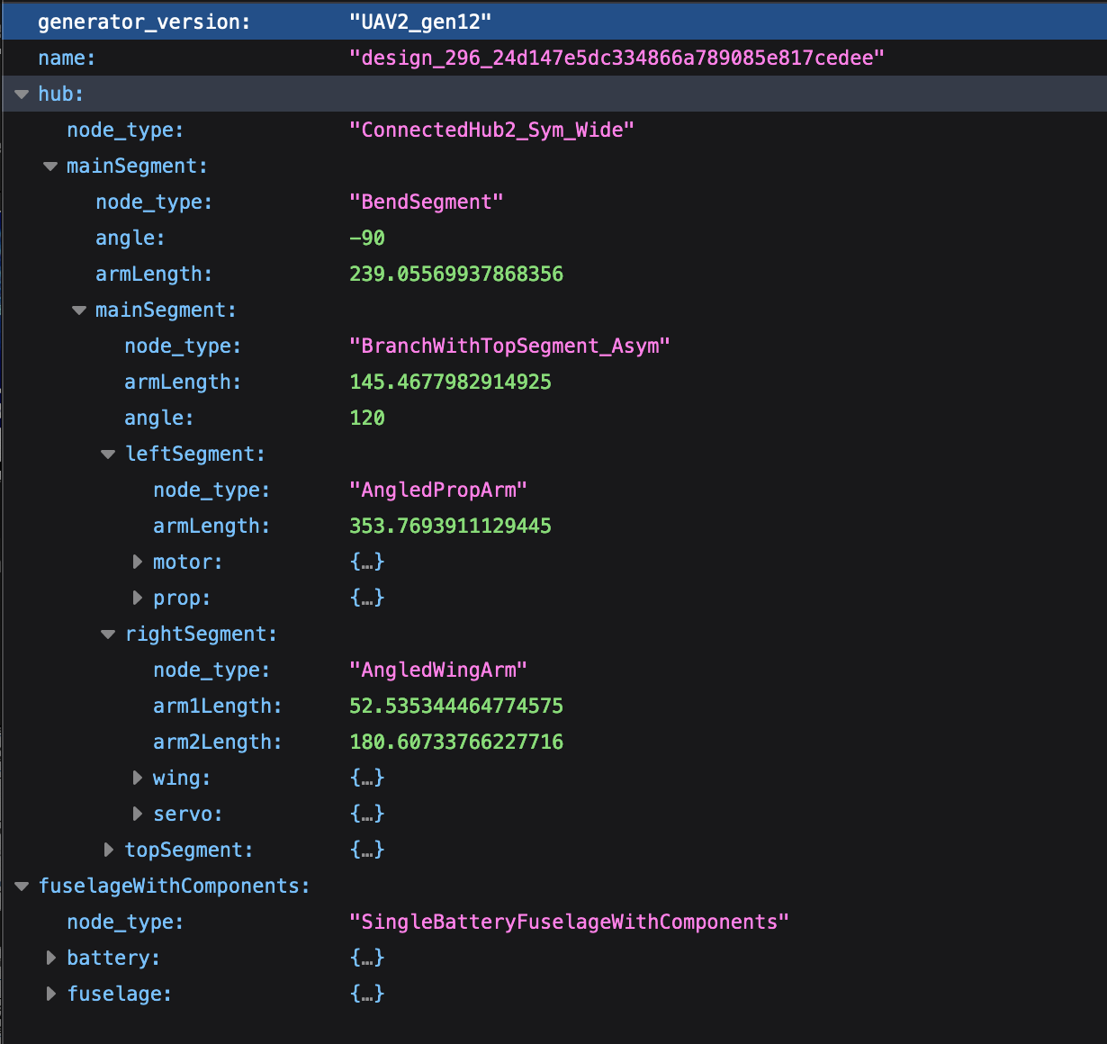
Symbolic Generator Using CRAIDL - a Declarative Probabilistic Programming Language
Distribution Statement A. Approved for Public Release, Distribution Unlimited

Slide 31
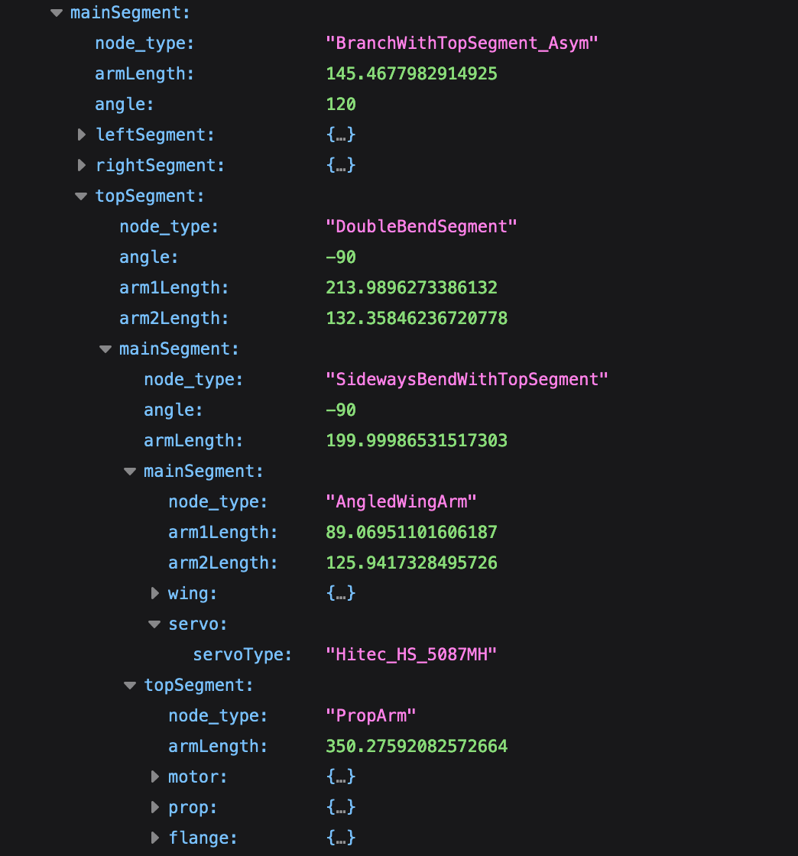
Symbolic Generator Using CRAIDL - a Declarative Probabilistic Programming Language
Distribution Statement A. Approved for Public Release, Distribution Unlimited

Slide 32
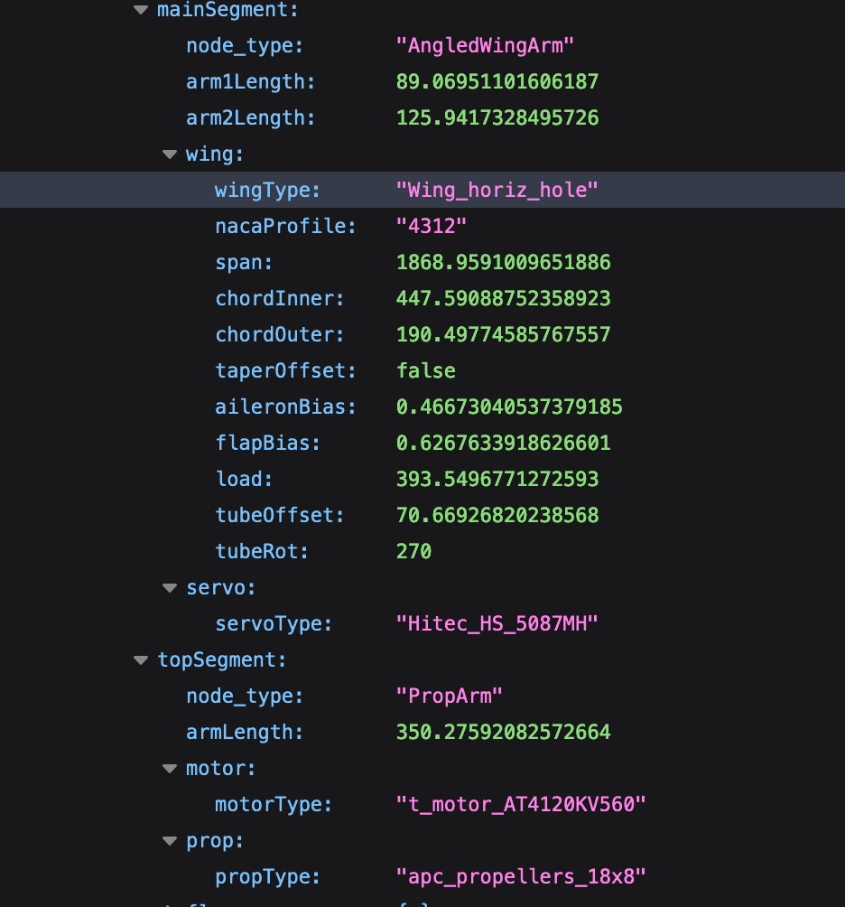
Symbolic Generator Using CRAIDL - a Declarative Probabilistic Programming Language
Distribution Statement A. Approved for Public Release, Distribution Unlimited

Slide 33
Minimizing Oracle Calls Using Surrogates
Intertwined generation of data and design optimization
Distribution Statement A. Approved for Public Release, Distribution Unlimited

Slide 34
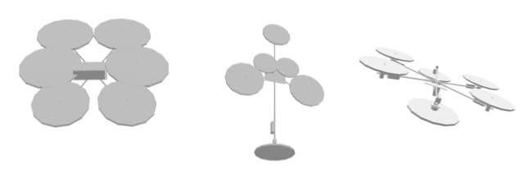
Iterative Feedback to Data Generator from Exploration
Need to make data generator objective-aware – Only a small percentage of designs meet the specification when the initial stochastic grammar. E.g. SwRI pipeline – out of 5000 designs, only 70 were valid. Direct tuning can lead to collapse of diversity.
Need to make evaluation faster - Scientific models can be slow to evaluate.
Need more valid designs for learning of rules and parameters – Feed valid designs back to learn the generator to improve valid generation but without losing diversity.
NS Generator: Stochastic Grammar for CRAIDL design language
Grammar Rules
Stochastic
Parameters
Example Designs
Oracles for evaluating design
Good Designs
Design Specification
Bad Designs
Scientific models
Distribution Statement A. Approved for Public Release, Distribution Unlimited
Notes:
Direct tuning can lead to collapse of diversity.

Slide 35
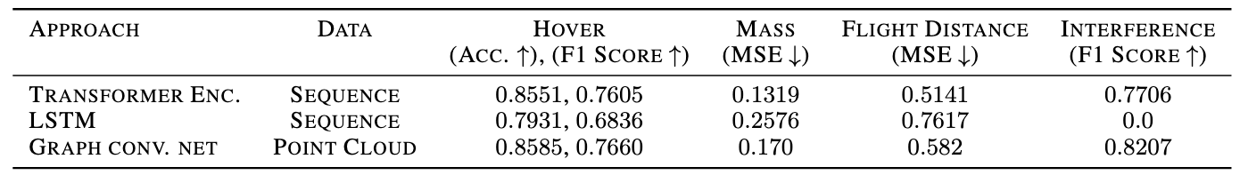
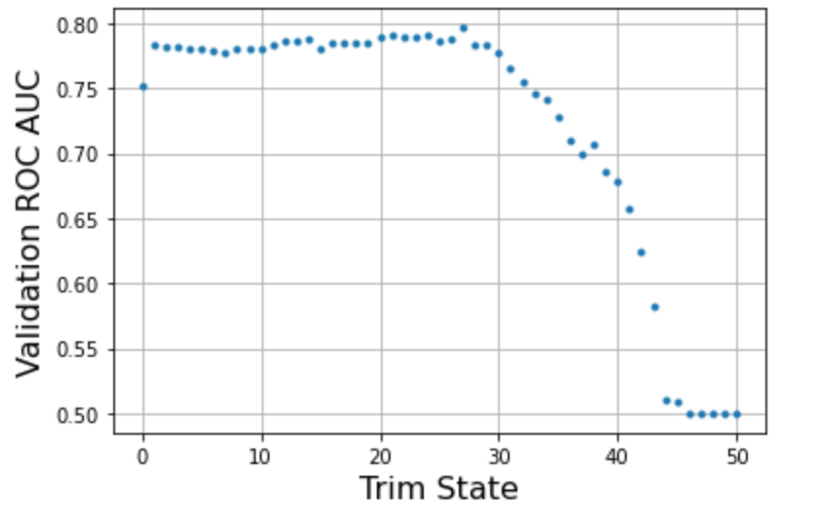
System-Level Surrogates
Distribution Statement A. Approved for Public Release, Distribution Unlimited

Slide 36
Generative Models for Design Topology
The transformer model saved 137.2 days of compute time
CRAIDL design language
Automate retraining of Stochastic Grammar to make it more directed
Enables successful learning design patterns
Grammar Rules
Stochastic
Parameters
Design Specification
(Ability to hover)
Good Designs
Hierarchy of Oracles
21,000
Example Designs
ML models
Good Designs
Scientific models
Symbolic rules
36.5 days compute
Bad Designs
Bad Designs
100,000 ~ order of minutes
79,000
36
Distribution Statement A. Approved for Public Release, Distribution Unlimited
Notes:
Direct tuning can lead to collapse of diversity.

Slide 37
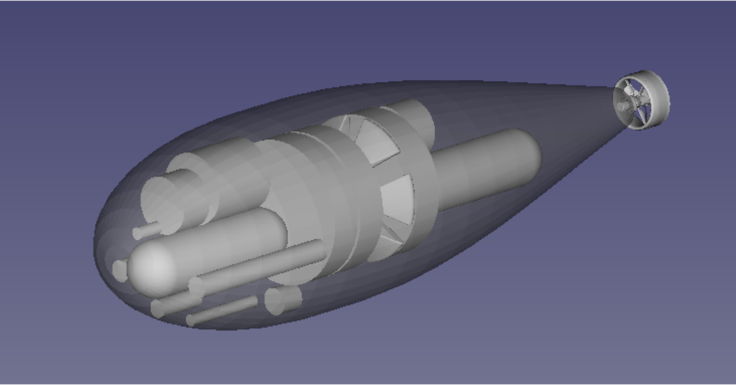
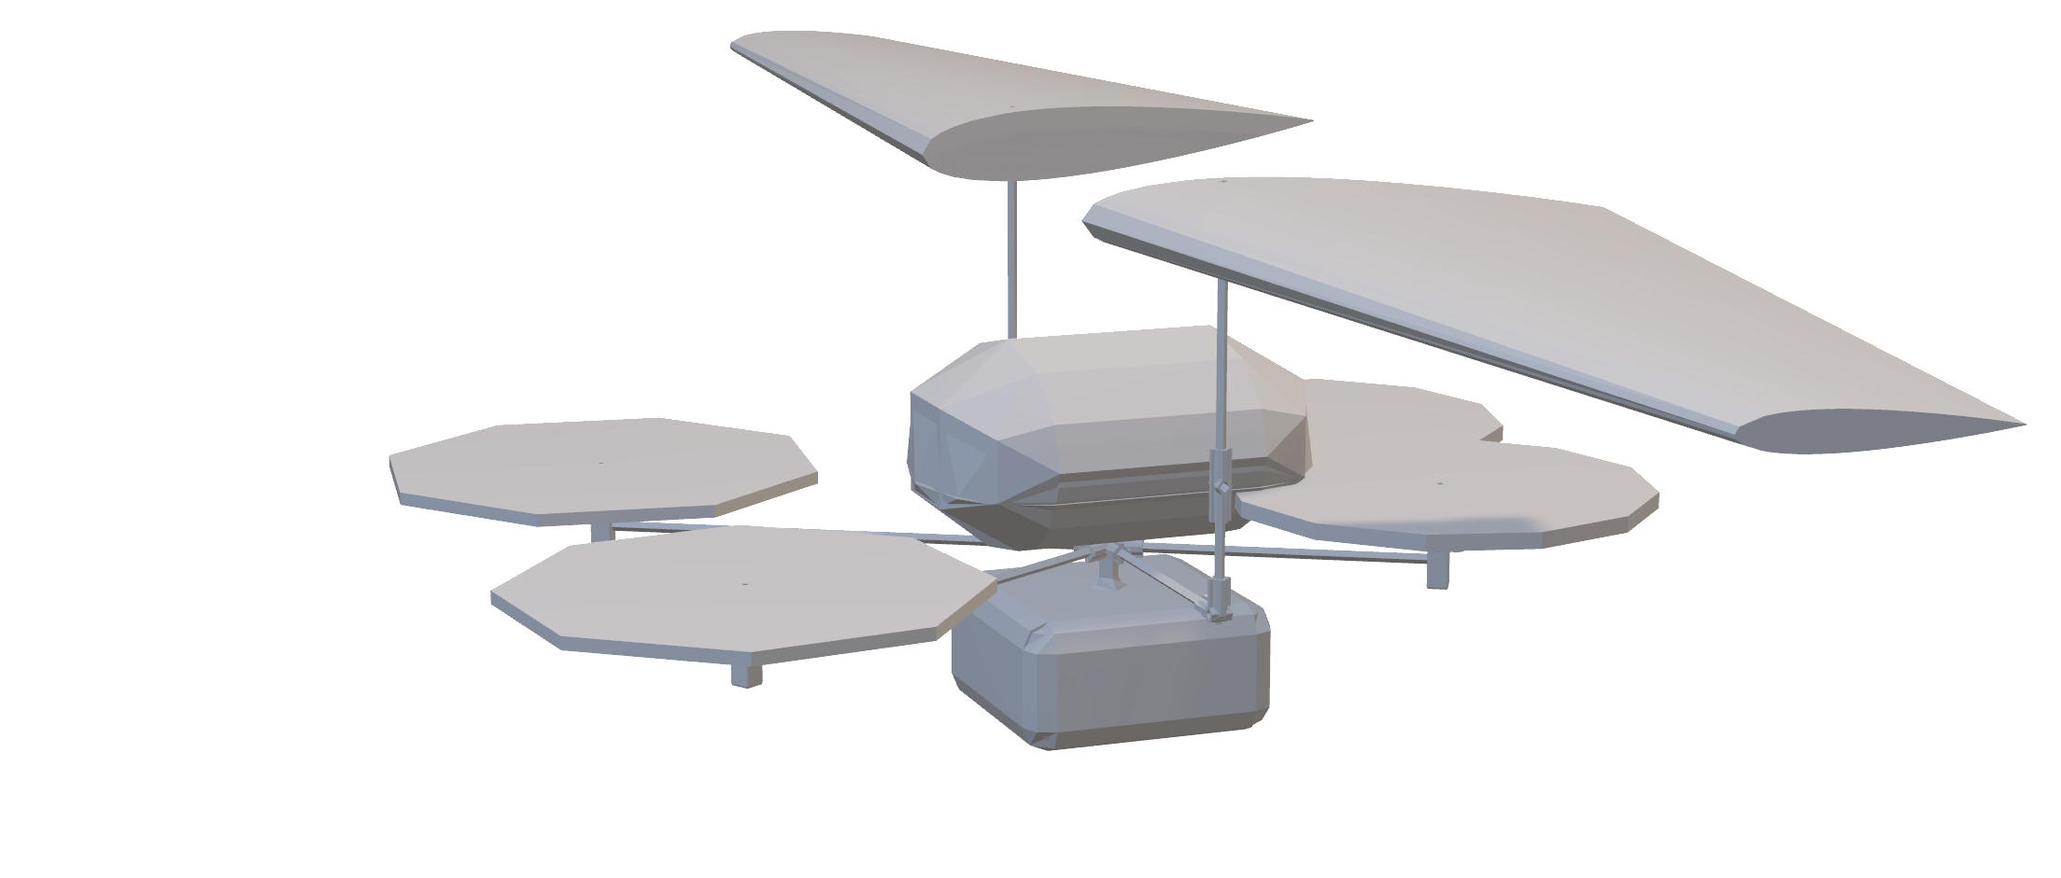
Results on Program (TA3) Corpus and Hackathons
Top Down Design:
Topology design followed by tuning component params
Bottom Up Design:
Component design followed by assembly
Distribution Statement A. Approved for Public Release, Distribution Unlimited

Slide 38










SwRI Athens Corpus: UAV/UAM
Design Flow
UAV/UAM design
Propulsion
System
Composition to Generate Seeds
Geometry
Parameter Tuning
Design Patterns
Topology Generation
Abstracted
Specifications
FDM Input:
Abstracted topology, propulsion,
control surfaces, Mass, Inertia
Max-Distance
Hover-time
Thrust, Lift
Final
Parameter Tuning
Mission
Specifications
Position
Velocity
Thrust/Lift
Control: Parametric
Distribution Statement A. Approved for Public Release, Distribution Unlimited

Slide 39





5 High Performing Designs
Beetle, Score: 7962
Daisy, Score: 5218
Frog, Score: 7920
Frog, Score: 5263
Water strider, Score: 5218
Distribution Statement A. Approved for Public Release, Distribution Unlimited

Slide 40





5 Top Creative Designs
Frog, Score: 3550
PrayingMantis, Score: 4944
Kite, Score: 4308
Walrus, Score: 5306
Vulture, Score: 5263
Distribution Statement A. Approved for Public Release, Distribution Unlimited

Slide 41









UAV Designs over the Program
Fall 2021
Spring 2022
Fall 2022
Distribution Statement A. Approved for Public Release, Distribution Unlimited

Slide 42

Diversity Summary Statistics
Distribution Statement A. Approved for Public Release, Distribution Unlimited

Slide 43






Nautilus STR Corpus: UUV
Design Flow
UUV design
Battery
Pressure vessel design
Manual
Component
Selection for
Mission
Component Layout, Buoyancy, Roll/Pitch
CFD and Fairing design
Propeller Opt
Abstracted
Specifications
Drag coefficient, force
Propeller efficiency
Power capacity
Energy requirement
Time requirement
Speed requirement
Mission
Specifications
Path planning
Altitude planning
Energy profile
Planning (and Control)
Distribution Statement A. Approved for Public Release, Distribution Unlimited

Slide 44





UUV Design
Minimum sensing distance: 7.5km
Total distance travelled: 4827.5km
Minimum distance to shore: 1445m from (81.34, -89.94)
Total distance travelled: 4257km
Minimum distance to shore: 4810m from (80.74, -79.36)
Robust Plan and Controller
Distribution Statement A. Approved for Public Release, Distribution Unlimited

Slide 45
UUV Design
Metric | Value
Energy Consumed | 201.2 KWh
Valid Path and Mission Complete | True
Energy Remaining | 50.3 KWh
Deployment x, y, z | (80.38, -85.11, -480)
Deployment Accuracy | 84 meters from bottom
Mission Duration | 55.9 days
Distance Travelled | 5310 km
Number Navigation Points | All navigation points met
Vehicle Rendering
Distribution Statement A. Approved for Public Release, Distribution Unlimited

Slide 46


UUV Design: Physical Design
Side
Names are color coded with the color of the rendering.
Altimeter
PV
Acoustic Comms
CTD
DVL
Foam
Top
OBS
Top
Key Vehicle Attributes
Length (m) | 4.99m
Max diameter (m) | 1.65m
Mass (kg) | 1357.1 Kg
CoB-CoG offset (m) | 0.050
Hotel power (W) | 19
Max vehicle speed (m/s) | 1.1
Pitch shifter
CAD Model
Distribution Statement A. Approved for Public Release, Distribution Unlimited

Slide 47

UUV Design: Physical Design Change from Ch0.5 to Ch1.0
Side
Ch0.5
Major Change
PVs became larger to carry larger battery.
More floats to compensate.
Fairing was already large enough.
Ch1
Distribution Statement A. Approved for Public Release, Distribution Unlimited

Slide 48


UUV Design: Pressure Vessel Design with Stiffners
Depth rating: 1300m include 30% safety margin
PV use stiffeners and we used Vern’s model.
PV rendering does not show stiffeners.
Ch0.5
Ch1
PV1
Shape – Cylinder with spherical end caps Length – 1.0m Outside-diameter – 0.389391m Stiffner_width – 0.003505m Stiffner_height – 0.027245m Stiffner_type – External e – 0.00038 Cylinder-thickness – 0.007408m Internal radius – 0.187287m Sphere-thickness – 0.004394m Internal-volume – 137.714L Mass – 35.9486kg Material – Al. 7075-T73 Depth-rating – 1000m with 1.3 safety factor Internal volume to mass ratio – 3.830845
PV1
Shape – Cylinder with spherical end caps Length – 1.0m Outside-diameter – 0.40m Stiffner_width – 0.0043m Stiffner_height – 0.0261m Stiffner_type – External e – 0.00038 Cylinder-thickness – 0.0079m Internal radius – 0.192m Sphere-thickness – 0.00452m Internal-volume – 146.3L Mass – 39.90kg Material – Al. 7075-T73 Depth-rating – 1000m with 1.3 safety factor Internal volume to mass ratio – 3.67
Overall, the wall thickness increases as the volume requirement also increases. Additionally, we can see that designs without stiffeners have a higher wall-thickness compared to designs with stiffeners.
Distribution Statement A. Approved for Public Release, Distribution Unlimited

Slide 49



UUV Design: Faring
Length | 4.990 m
Diameter | 1.650 m
Nose length | 1.5 m
Body length | 0.378 m
Tail length | 3.122 m
Teardrop fairing: lower drag, better packing
Pressure field
Velocity field
Distribution Statement A. Approved for Public Release, Distribution Unlimited

Slide 50
Distribution Statement A. Approved for Public Release, Distribution Unlimited
TA1 | Metric |  | NuSymCORE | Phase 1 | Phase 2 | Phase 3
TA1.1: Design Space Construction | Design space size (mined design variants) |  | Over 100,000 Topology (Air) Millions Parametric | 100’s | 1,000’s | 10,000’s
TA1.2: Design Composition | Autocomplete partial designs (completeness/ accuracy) | Connections | Topology – 100% | 50%/80% | 90%/90% | 100%/95%
 |  | Interface Components | Propulsion Chain – 100% | 40%/80% | 70%/90% | 90%/95%
 |  | Functional Components | Pressure Vessel – 100% Faring – 80% (identify parameter space manually) | 20%/80% | 50%/90% | 80%/95%
TA1.3: Design Space Exploration | Domains jointly explored |  | Multiple – Control, Energy, Structural | Multiple (2) | Multiple (3) | Multiple (4)
 | Designs explored (combinatorial + parametric) |  | Millions of Design | 1,000’s (Automated) | 100,000’s (Automated) | 1,000,000’s (Automated)

Slide 51



TA2 Interaction: SRI TA2 Team (Worked together on UAV and UUV)
Distribution Statement A. Approved for Public Release, Distribution Unlimited

Slide 52

TA2 Interaction: CRA JARVIS (UAV)
Distribution Statement A. Approved for Public Release, Distribution Unlimited

Slide 53


TrinityAI Designs vs DALL-E-2
TrinityAI
DALL-E-2
Distribution Statement A. Approved for Public Release, Distribution Unlimited

Slide 54
Publications (available at https://nusci.csl.sri.com/publication/ )
Key Research Publications
Edmond Cunningham, Adam Cobb, Susmit Jha. Principal Manifold Flows. 39th International Conference on Machine Learning (ICML), 2022.
Cobb, Adam; Roy, Anirban; Elenius, Daniel; Koneripalli, Kaushik; Jha, Susmit. On Diverse System-Level Design Using Manifold Learning and Partial Simulated Annealing. 17th International Design Conference (DESIGN), 2022. Identified as Top 10% of papers at the venue.
Cobb, Adam; Roy, Anirban; Elenius, Daniel; Jha, Susmit. Trinity AI Co-Designer. Design Automation for CPS and IoT (DESTION 2022).
Chenxi Yang, Swarat Chaudhuri (2022). Safe Neurosymbolic Learning with Differentiable Symbolic Execution. International Conference on Learning Representations (ICLR), 2022
Agrawal, A., & McComb, C. Comparison of Visualization Strategies for High-Dimensional Exploration Behavior of CPS Design Agents. Design Automation for CPS and IoT (DESTION 2022).
Agrawal, A., & McComb, C (2022). Reinforcement learning for efficient design space exploration with variable fidelity analysis models. Journal of Computers and Information Science in Engineering, 2022.
Li, M., & McComb, C. Using Physics-Informed Generative Adversarial Networks to Perform Super-Resolution for Multiphase Fluid Simulations. Journal of Computers and Information Science in Engineering, 2021
Samuel Kessler, Adam Cobb, Stefan Zohren, Stephen J. Roberts. Can Sequential Bayesian Inference Solve Continual Learning? Advances in Approximate Bayesian Inference (ABI), 2021
Thank you!
Distribution Statement A. Approved for Public Release, Distribution Unlimited

